Slide 1



The Future of EU
Development Cooperation
Navigating Trade-Offs in a Contested World

Slide 2
Opening Remarks
The Future of EU Development Cooperation: Navigating Trade-Offs in a Contested World

Slide 3
Ruth Parkin
Director, EU Unit, Development Cooperation & Africa Division, Department of Foreign Affairs and Trade, Ireland

Slide 4

The Future of EU Development Cooperation: An African Perspective
Dr. Gamal Ibrahim, Chief, Macroeconomic Analysis, Institutions and Economic Governance Section.
UN Economic Commission for Africa (UNECA).

Slide 5

A Difficult Time for Multilateralism
The global landscape is undergoing significant shifts, creating a challenging environment for international development cooperation.
Intensifying geopolitical competition is fragmenting the international system.
National priorities and domestic politics increasingly shape foreign engagement.
Focus is shifting to security, migration, supply chains, and access to critical minerals.
Governments are pressured to show that external spending serves direct national interests.

Slide 6
Africa's Enormous Financing Challenge
Africa’s development ambitions far exceed available financing, at a time when development assistance is also declining.
$670B - $762B
$88.6 Billion
16 Percent
Annual loss due to illicit financial flows.
Africa's average tax-to-GDP ratio, indicating a need for improved domestic resource mobilization.
Annual SDG financing gap Africa faces by 2030.
2.5 Percent
↓ 23.1 Percent
↓23.9 Percent
Africa’s share of global exports.
Bilateral ODA from all DAC donors to Africa in 2025.
Global Bilateral ODA by DAC members fell in 2025.

Slide 7
Redefining "Mutual Interest“: negotiated not assumed
European and African interests can reinforce one another, but they do not always coincide.
Define Mutual Interest Jointly
Define jointly what is financed and how. Africa must be at the table from the outset, not just consulted.
Focus on Development Impact
Success should not be measured by mobilized private capital alone, but by the tangible development impact, risk distribution, and support for national priorities.
Critical minerals illustrate the trade-off: European supply security versus African processing, jobs and value addition.
A true partnership requires moving beyond a traditional donor-recipient dynamic.
Whose interests are being served? Europe's collective interests, national interests, or commercial interests?
Africa must be at the table when decisions are made, not simply consulted after priorities are set elsewhere

Slide 8
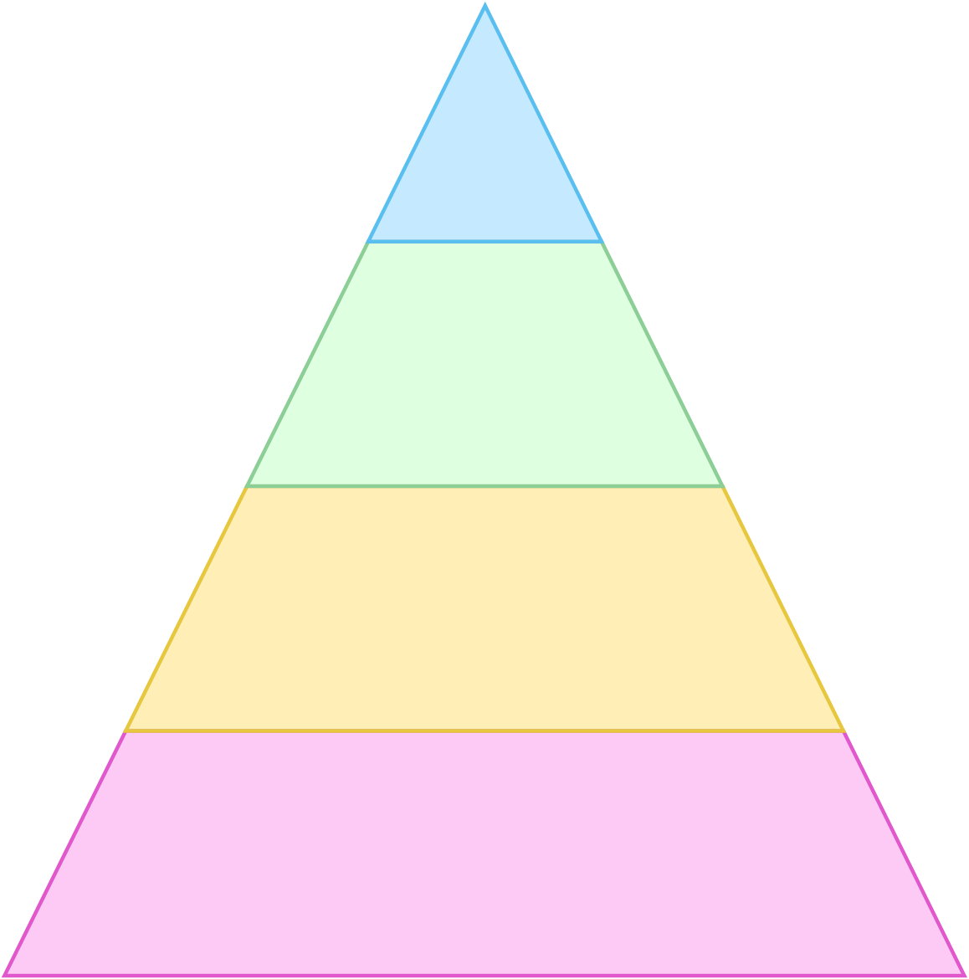
An African Proposition: A Partnership for Structural Transformation
Development cooperation, trade, investment and technology should align with Africa’s development priorities.
Effective Development & Lasting Partnership
A Shift in Focus
Building productive capacity, promote local value addition, and integrating regionally through the African Continental Free Trade Area (AfCFTA). A strategic partnership must develop processing, manufacturing, and technology within Africa, not just secure access to raw materials.
Appropriate Financing Instruments (INFFs)
National Development Plans & Priorities
Broad Ownership: Governments, Private Sector, Civil Society

Slide 9
Five Propositions for the Future Partnership
1. Preserve Development Finance Integrity
  Honour ODA commitments, ensure climate finance is additional, and preserve concessional finance for non-commercial development needs.
2. Put Country Ownership into Practice
  Use national development plans and Integrated National Financing Frameworks (INFFs) as the starting point for all initiatives.
3. Define Mutual Interest Jointly
  Ensure African countries participate from the outset in setting priorities, choosing instruments, and assessing results.
4. Judge Private Finance by Development Impact
  Assess private and blended finance by its developmental additionality, not just he volume of capital mobilized.
5. Make Structural Transformation Central
  Focus engagement on contributing to African value addition, manufacturing, technology, skills, and regional value chains.

Slide 10

Mutual Interest
Prof. Dr. Rainer Thiele, Kiel Institute for the World Economy

Slide 11
Why Mutual Interest ODA?
Budgets are shrinking: Defence and other domestic spending compete for the same funds.
Public support is falling: Voters increasingly see aid as ineffective charity that does not benefit ordinary people.
Mutual Interest ODA: Politically more sustainable by providing visible benefits for donor countries while retaining a focus on welfare in partner countries.

Slide 12
When can we call ODA “Mutual Interest”?
If it provides benefits for donor and improves recipient population’s welfare.
Not necessarily within the same domain and timeframe.

Slide 13
When can we call ODA “Mutual Interest”?
Donor Benefits | Recipient Benefits | Classification
High | High | Clear case of mutual interest ODA
High | Low/Zero/Negative | Narrowly self-interested aid
Low/Zero/Negative | High | Primarily recipient-focused aid, altruistic
Low/Zero/Negative | Low/Zero/Negative | Low benefit aid

Slide 14
Key dimensions of donor benefits
 | Domain of benefits
 | Economic | Political & Diplomatic | Security & Stability
Short-term | Tied Aid | UNGA votes | Enlisting recipient’s support for peacekeeping missions
Longer-term | Aid’s growth effect | Leadership in multilateral arenas including soft power benefits | Preventing pandemics; stabilising climate; reducing root causes of conflict and irregular migration
Timing of benefits

Slide 15
Panel 1: Mutual interests in practice
How should Global Europe balance development, economic and geopolitical objectives?

Slide 16
Coffee Break
The Future of EU Development Cooperation: Navigating Trade-Offs in a Contested World

Slide 17
Panel 2: Preventing strategic blind spots
Sustaining engagement in fragile contexts and long-term development priorities.

Slide 18
Thank You
The Future of EU Development Cooperation: Navigating Trade-Offs in a Contested World

