Slide 1
Making EU-Africa relations future-proof
Key questions in the run up to the Summit and the role of the PAP
Faten Aggad, Program Manager, Africa’s Change Dynamics Program
Presentation to the Pan-African Parliament
17 March 2014

Slide 2
Overview of the presentation
Part 1: General
Evolving context
The ‘psychology’ of the partnership
Part 2:
The JAES
Implementation of the JAES
Questions to be addressed
Part 3:
Issues for the way forward
Principles of the partnership
Part 4: PAP
The role of the PAP

Slide 3
An Evolving context…
A new context in both continents, especially since 2007:
In Europe: Economic, financial and political crisis, in-ward looking while looking for opportunities to reestablish influence externally, increasing challenges to balance values and interests
In Africa: unprecedented economic growth in most countries, diversification of partners, challenge of rising inequality and a youth bulge
Globally: a shifting balance of economic and political power

Slide 4
Perceptions continue to shape the partnership on both sides…
“Misperceptions are on both sides: in Europe and in Africa… in Europe not all countries are former colonial powers. The EU is not a homogeneous group…Africa is also not only a continent of poverty and wars” – Speaker at the AUC-ECDPM meeting, Addis 28 February ‘14

Slide 5
Both continents have work to do to address perceptions
- Europe has problems of credibility and consistency (i.e. “EPAs are a well-intentioned diplomatic disaster”, Difficulties in reconciling EU value driven agenda with EU security and economic interests, who ‘leads’ Europe?, etc.)
- Africa can also do more (“aid is a necessity for some African countries but not a necessity for Africa”? perception of dependence on EU funding, difficulty to ‘speak with one voice’, etc.)

Slide 6
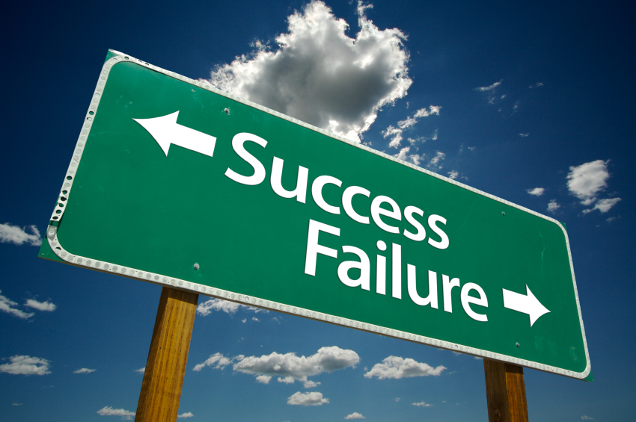
The partnership since Lisbon (2007)

Slide 7
What happened since Lisbon, 2007?
The Lisbon Declaration(2007) launching the Joint Africa-EU Strategy was an ambitious, strategic and aimed to establish a political partnership:
Continent to continent partnership
Treating Africa as one
Partnership beyond aid (8 key areas)
Dealing with issues of common concern and interest
Multi-actor involvement

Slide 8
What happened since Lisbon, 2007?
But mixed results:
Limited political traction
Diverse implementation of 8 partnerships: each at its own pace, various dialogues and processes (i.e. positive cooperation around the energy partnership but limited progress on migration, etc.)
Political tensions hindered progress : EPAs, ICC, major security crises
“‘Inertia’ is the term associated with the partnership according to consulted African stakeholders”
“Strategies are supposed to create coherence of action but the JAES created a fragmented approach

Slide 9
Making the JAES work
High-level political leadership & Improve quality of dialogue
Align partnershi§ps to continental agendas: “Relations should be redefined in the framework of mutual interests”
The appropriate institutional framework supportive of different stakeholders involvement

Slide 10
Guiding principles for the future?
Changed in perceptions and mentalities key for a constructive, mutually beneficial partnership
Openly discuss mutual and shared interests
The EU needs to move beyond ‘conditionality’ towards ‘shared-responsibility’
Africa: support “home grown” initiatives, review strategic partnerships and mobilise own resources to maintain independence of action (= tackling longstanding asymmetry in the partnership)
Agree to disagree on some issues

Slide 11
The Role of the Pan-African Parliament
Key actor in the institutional set-up and can potentially play a more important role by intensifying dialogue with the European Parliament (EP)

Slide 12
The Role of the Pan-African Parliament
Contribute in improving the national-continental-international nexus (Cotonou-JAES link)
Raise awareness and strengthen dialogue around African priorities with the EP, which is expected to play a more central role in financing
Support efforts on political dialogue around sensitive issues (i.e. EPAs, ICC, LGBT rights, etc.)
Monitoring and oversights on questions that the PAP committees deal with

Slide 13
Thank you
www.ecdpm.org
www.africaeu2014.blogspot.nl

