Slide 1
PHARMACEUTICAL MANUFACTURING PLAN FOR AFRICA

Slide 2
Key Continental Initiatives
AMRH-& AMA
AfCFTA- anchored Local Pharmaceuticals Production initiative
Africa Medical Supply Platform
5 Africa Pharma Conference initiatives (Annual Conference; best practices framework, Africa pharma LMS,FAPD)
Partnership for Africa Vaccine Manufacturing
Home Grown Solutions Accelerator

Slide 3
Our Ask to Stakeholders..
ADOPT A GOVERNANCE FRAMEWORK FOR EFFECTIVE COORDINATION OF THE IMPLEMENTAION OF PMPA
CONSOLIDATE CONTENT FOR A COMPENDIUM OF GOOD PHARMA POLICIES AND PRACTICES

Slide 4
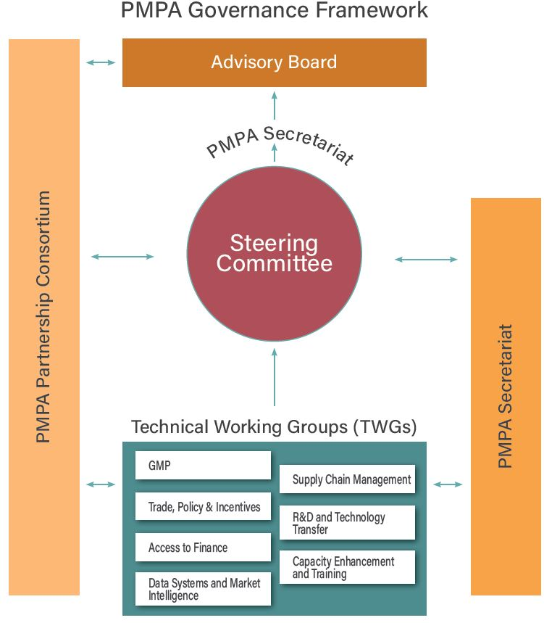

Slide 5

Thank you!

